Slide 1

LSU STEM Pathways
Presenters: Vanessa Begat and Frank Neubrander Louisiana State University (LSU)
A collaborative effort of the East Baton Rouge Parish School System, LSU Cain Center, LEE Magnet HS,
LSU Colleges of Art & Design, Engineering, Music & Dramatic Arts, Science, LSU Center for Computation and Technology, and the Louisiana Biomedical Research Network

Slide 2
STEM Pathways Vision
Build teacher STEM experts
Design quality STEM curriculum
Create a pathway for ALL students
Increase the number of Louisiana students who take quality STEM courses in high school
Notes:
Before we get into Intro to Engineering for dual enrollment credit, I want to take a step back and show you how Intro to Engineering fits into the bigger picture in the state of Louisiana, and how we’ve been able to use it to grow high quality STEM courses in the state. We were tasked by the state to develop a series of courses along several pathways that would increase the number of students taking high quality STEM courses in high school. We did this by focusing on these three components: building teacher stem content, design quality stem curriculum, and creating a pathway that is accessible to all students.

Slide 3
Jump Start
Diploma
TOPS University Diploma
Notes:
How did we get started? In 2014 LDOE, EBR, Lee High and LSU partnered to create academies for the new Lee High that would bring high quality STEM courses to the classroom. We were challenged to create courses that met the needs of both Jumpstart students and high performing college bound students.

Slide 4
Pre-Engineering
Digital Design & Emergent Media
Computational Thinking
and
21st Century Skills
Computing
Biomedical Sciences

Slide 5
Pre-Engineering:
Arduino & VEXCode (C/C++)
Digital Design & Emergent Media:
Javascript & Arduino
Functional Programming:
Haskall
(Abstraction, Logic,
Effect of Code)
COMPUTING:
Scratch, Python, JavaScript, R, Java, C/C++
Biomedical Sciences:
Arduino

Slide 6
LSU Pre-Engineering
Required Core Courses
(Jump Start and TOPS SILVER STEM Endorsements)
Intro to Engineering (DE optional) (846)
Intro to Computational Thinking (668)
Intro to Robotics (267)
Principles of Engineering (can be substituted for Physical Science) (92)
LSU Engineering Electives
(Jump Start and TOPS GOLD STEM Endorsements)
Engineering Design and Development
Engineering Economy (DE optional)
Programming for Engineers
Data Manipulation and Analysis
TOPS Choose 4 from either category
Other Electives
(Jump Start and TOPS GOLD STEM Endorsements)
AP Calculus, Statistics
AP/DE/II: Chem/Bio/Physics
AP Computer Science A/P
Electives from other Louisiana STEM Pathways
Other approved Electives (CTEC etc.)
Notes:
Numbers represent 2019-20 student enrollments

Slide 7
Guest Speakers, Hands on Projects, Lab Reports/Presentations
Pre-Engineering
Core Courses
Functional Programming to learn abstraction, logic, effect of code
Intro to Engineering
Intro to Computational Thinking
Intro to Robotics
Principles of Engineering
VEX based hands on building of robots paired with programming sensors for autonomous movement
3 week in-depth study of each engineering discipline through hands on project
Notes:
Intro to Engineering is meant to get the kids excited. Not “rigorous” in the true sense of the word as far as content goes but rigorous in work ethic and commitment to learning. Light on math but heavy on teamwork, communication, and general responsibility while doing fun projects and being exposed to true STEM professionals.
Intro to Robotics focuses on both building concepts as well as programming. In the building phase, they will learn applied math by applying gear reductions and wheel size to determine distance travelled. In the programming phase, students will create a robot that can follow a parade route and throw beads among other projects.
Principles of Engineering takes the intro to engineering course and takes students more in depth in each discipline. Here students will be introduced to a concept that involved math and then do a hands on project to reinforce the math concepts. They will continue the same practices as Intro to Eng by writing a lab report and creating a presentation at the end of each discipline. Students will do things like build a hydraulic robotic arm or create an infinity gauntlet based on their circuit analysis.

Slide 8
LSU Digital Design & Emergent Media
Required Core Courses
(Jump Start and TOPS SILVER STEM Endorsements)
Digital Storytelling (TOPS Art credit) (413)
Intro to Computational Thinking (668)
Coding for the Web (36)
Programming for Digital Media (DE option) (44)
LSU DDEM Electives
(Jump Start and TOPS GOLD STEM Endorsements)
Sound Design (DE option)
Basic/Advanced Film
Film/Television
Video Game Design
Digital Image & Motion Graphics (DE option)
Digital Media Capstone
Data Manipulation and Analysis
Programming for STEM
TOPS Choose 4 from either category
Other Electives
(Jump Start and TOPS GOLD STEM Endorsements)
Electives from other Louisiana STEM Pathways
Other approved Electives
AP: CS A/P, Art, Calculus, Statistics
Photography I & II

Slide 9
LSU Biomedical Sciences
Required Core Courses
(Jump Start and TOPS SILVER STEM Endorsements)
Introduction to Biomedical Sciences (137)
Introduction to Computational Thinking (668)
Comparative Anatomy & Physiology (42)
Senior Capstone (7) OR Data Manipulation and Analysis
LSU Biomedical Sciences Electives
(Jump Start and TOPS GOLD STEM Endorsements)
Data Manipulation
and Analysis
Bioinformatics
Forensic Science
Conservation Biology
Senior Capstone
Genetics
TOPS Choose 4 from either category
Other Electives
(Jump Start and TOPS GOLD STEM Endorsements)
(AP/DE/II) Biology, Chemistry,
Environmental Science, Statistics, Psychology
Electives from other Louisiana STEM Pathways
Other approved Electives (CTEC etc.)

Slide 10
LSU Computing
Required Core Courses
(Jump Start and TOPS SILVER STEM Endorsements)
Intro to Computational Thinking (668)
Data Manipulation & Analysis OR Programming for STEM
Cybersecurity OR AP CS Principles
Survey of Computer Science (23) OR Interactive Computing
LSU Computing Electives
(Jump Start and TOPS GOLD STEM Endorsements)
Programming for STEM
Data Manipulation & Analysis
Cybersecurity
Interactive Computing
Robotics
Coding for the Web
Video Game Design
Bioinformatics
Programming Digital Media
TOPS Choose 4 from either category
Other Electives
(Jump Start and TOPS GOLD STEM Endorsements)
AP: CS A/P, Calculus, Statistics, Physics
Computer Science I (DE option)
Electives from other Louisiana STEM Pathways
Other Approved Electives (CTEC etc.)

Slide 11

LSU STEM PATHWAYS PROGRAM
Strategies used to bring the Pathways to Louisiana Schools, Districts, and Universities

Slide 12
2014-2015
EBRPSS: LEE High Reconstitution
EBRPSS partners with LSU’s Cain Center
Ohio STEM Learning Network (Battelle)
LEE HS STEM Academies
2016-2017
Pre-Engineering Pathway approved
Pilot at LEE HS
Total: 1 school < 100 students
2017-2018
Intro to Engineering
Intro to Computational Thinking
Total: 7 Schools 5 Districts 299 Students
2018-2019
DDEM Pathway approved and piloted
Pre-Engineering Expansion
Total: 24 Schools 13 Districts 1676 Students
2019-2020
Biomedical Sciences and Computing Pathways approved
Total: 35 Schools 20 Districts 2800+ Students
2018-19: 72 % “high-needs” students (as defined by US DoE) and 60 % Black or Hispanic students.

Slide 13


16-17: EBR (1), Lee High
17-18: EBR (3), Central, Iberville, Jefferson, Pointe Coupee, West Feliciana
18-19: EBR (8), Ascension (4), Baker, Central, Iberville, Jefferson (2) , Lafayette, Pointe Coupee, St. James, St. John the Baptist, St. Martinville, Washington, West Feliciana, Rapides (1), Charter (1), Private (3)
19-20: EBR (8), Ascension (4), Baker, Calcasieu, Central, Evangeline, Iberville (2), Jefferson (2), Lafayette, Livingston, Orleans, Pointe Coupee, St. James, St. John the Baptist, St. Landry, St. Martin, Washington, West Feliciana, Rapides, Richland, Charter (2), Private (3)
Notes:
How many schools? How many parishes?

Slide 14

LSU STEM Pathways Franchises
UL Monroe: Starting in Summer 2020, the LSU Biomedical Sciences Pathway and the LSU Computing Pathway will be offered in North Louisiana by ULM (identical format, identical courses, but certification and teacher training provided regionally by ULM).
McNeese State University will be offering the LSU Pre-Engineering Pathway starting in 2020 (identical format, identical courses, but certification and teacher training provided regionally by McNeese).
LSU Shreveport will be offering Virtual Math Institute training in Summer 2020.
Notes:
How many schools? How many parishes?

Slide 15
WHY DO A STEM PATHWAY?
$482/student in additional CDF/CTE funding
Accountability points for IBC and DE courses
School/District
Graduate credit opportunity (LSU Colleges of Engineering and Sciences)
Teaching cutting-edge STEM courses, no EOC tests
Micro-Credentials for Teachers (BloomBoard, RAND Corporation, LDoE, LSU)
Math Praxis Preparation (Math Teacher Shortage)
Teachers
Students
High quality and engaging STEM courses
Project-based learning, highlighting 21st century skills
High School Diploma Silver/Gold STEM Seals
Universities
Recruiting & Retention & Federal Funding
School districts pay a $96 administrative fee for each student receiving a university-issued STEM Pathway Certificate. Funds received are fully re-invested in the program and its open source curricula
Students

Slide 16
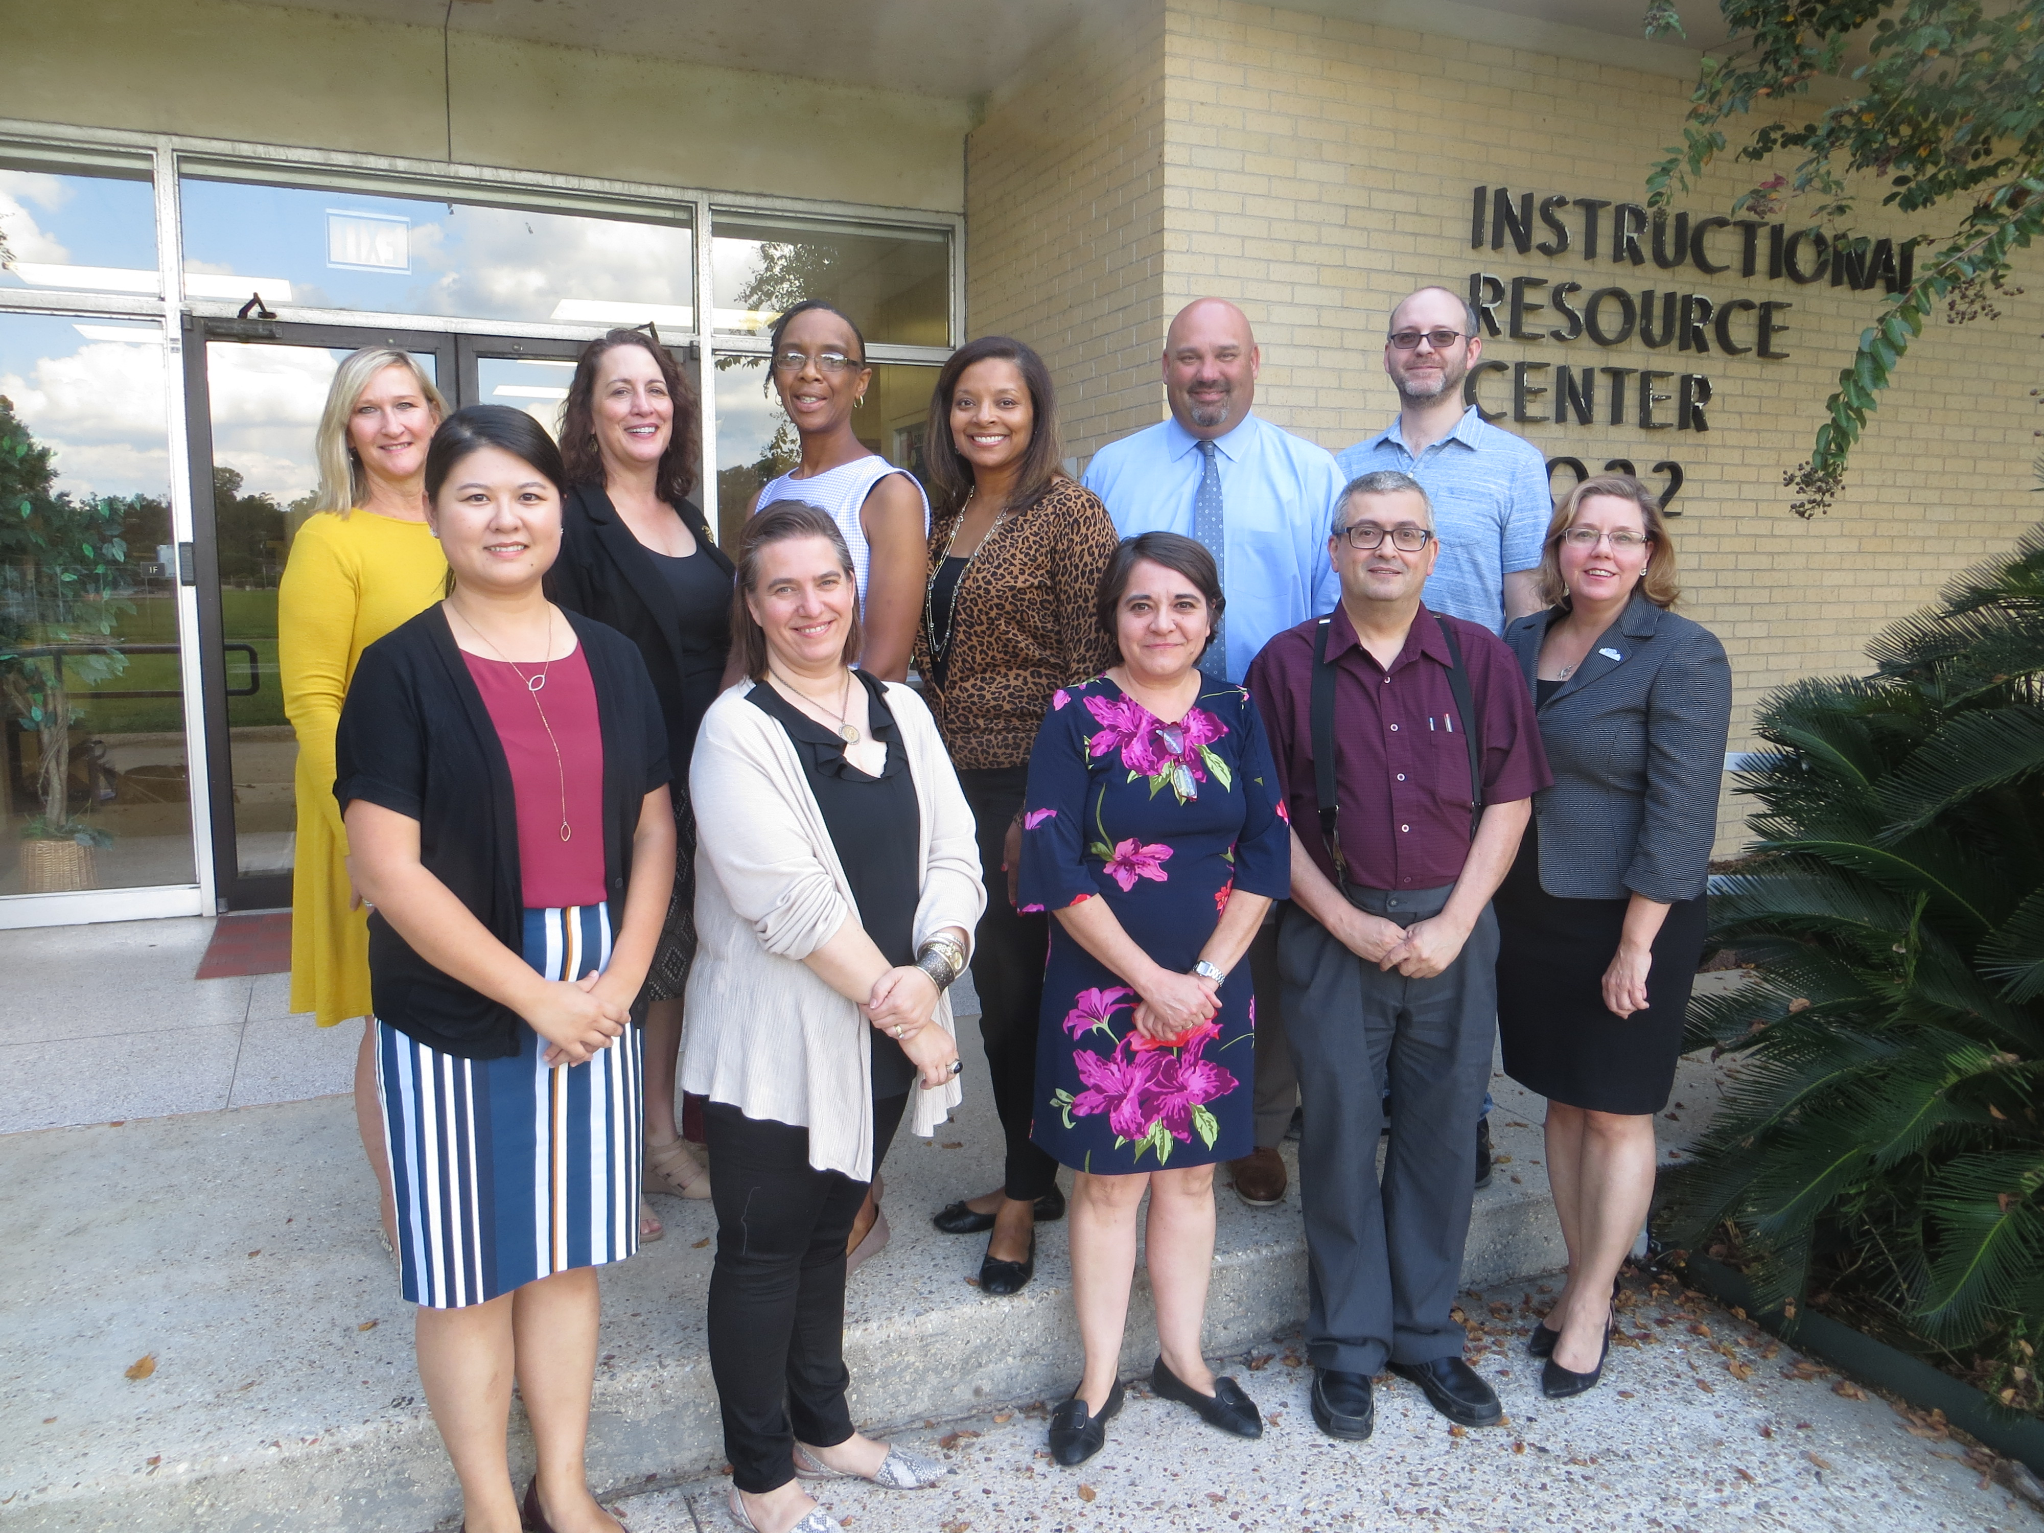
WHY DO A STEM PATHWAY?
Federal Funding for Districts and Universities
From 2020 on, supported by $5M in federal funding, LSU and the East Baton Rouge Parish School System will be expanding the LSU Computing Pathway to middle schools and will expand the reach of Introduction to Computational Thinking, a foundational core course in all four LSU STEM Pathways, to schools across the state.
Districts & Universities
“Our team is committed to promoting equity and to attracting more students from historically disadvantaged groups into computing fields.”
Lori L. Martin, LSU Sociology, Co-PI
Students

Slide 17

WHY DO A STEM PATHWAY?
Federal Funding for Universities and State:
From 2020 on, supported by $4M in federal funding, a collaborative effort of the Louisiana Department of Education, the RAND Corporation, BloomBoard, and LSU will be rolling out Micro-Credentials for STEM Pathway teachers
Universities
&
State
Core Skills for All STEM Pathway Educators
Developing Technical Reading, Writing & Presentation Skills
Facilitating Project-Based Learning
Understanding Computational Thinking
Pre-Engineering Pathway
Technical Drafting in 2D and 3D
Electrical Circuitry and Programming
Engineering Economics and Program Management
Engineering Ethics and Safety
The Engineering Design Process
Foundational Concepts of Robotics
Students

Slide 18

WHO MAY FACILITATE THE
PATHWAY COURSES?
Any teacher can learn how to facilitate a LSU STEM Pathways course. Main prerequisite: must have a passion to learn!
Experienced teachers, technical or non-technical, from all fields
Novice teachers, certified and uncertified
Optional Math Praxis Preparation
Teachers
2019-20:
90+ trained LSU STEM Pathways teachers, 40 high schools, 22 districts

Slide 19


STEM PATHWAYS TEACHER
SUMMER TRAINING INSTITUTE
Mandatory 3 or 6 weeks intensive summer training; monthly Saturday follow-up workshops
Registration fee of $1,920 or $3,840 per teacher
Can be taken for LSU graduate credit (LSU Colleges of Engineering and Science)
Starting in 2020: micro-credentials
District responsible for stipend, dorm, tuition, fees
1 student = $482 - $96 = $386;
20 students * $386 = $7,720 return to district
LEE HS teacher Katy Ullrich teaches Intro to Computational Thinking

Slide 20
LSU STEM PATHWAYS PROGRAM
Students Win, Parents Win, Teachers Win, Schools Win, Districts Win, Universities Win, the State’s STEM Workforce Wins

Slide 21
Contact Information
Overall:
Dr. Frank Neubrander fneubr1@lsu.edu
Pre-Engineering:
Vanessa Begat vbegat@lsu.edu
Digital Design & Emergent Media:
Anthony Marasco amarasco@lsu.edu
Dr. Jesse Allison jtallison@lsu.edu
Computing:
Fernando Alegre info@brbytes.org
Biomedical Sciences:
Stephen Kampen skampen1@lsu.edu

